Slide 1
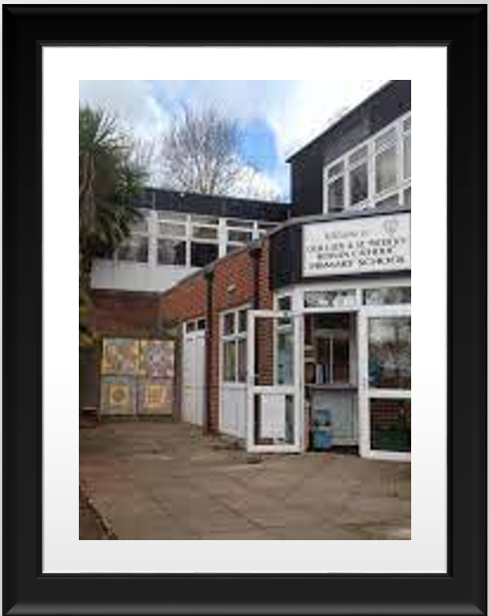
Our Lady & St Patrick’s Catholic Nursery and Primary School
Fourth Avenue, Teignmouth TQ14 9DT
Tel: 01626 773905
e-mail: office @olsp.uk
Living, Loving and Learning in God’s Way
Newsletter: 21st February 2023
Executive Head Teacher: Mrs Cathy Blatchford

Slide 2
Head Teacher update
Welcome back to Spring 2, which brings us into the second half of the academic year. School diaries are full and we are excited to see what this term brings.
Yesterday for OLSP was still a school day and we ensured the staff worked hard. We have revisited our behaviour policy to ensure there is consistency of practice and we maintain the high standards and expectations in place. We refreshed anaphylaxis training and learnt more about how to support children with dyslexia or other difficulties with literacy.
Please do remember that parents evenings are this week and these are important dates for your children. They are keen to share with you how things are going so far and it is important for you to know what the next steps are. It is not too late, so do contact the office to book an appointment.
We have had a superb number of children entering our Junior Speaks competition this year and are looking forward to hearing their talks. The heats are on 28th February and
Finally, I need to say a huge thank you to our ‘Friends of OLSP’ and the wonderful work they carried out on Ground Force Day. The help and support we have received to work on our school environment has been invaluable. There is still much to do, so do look out for our next date. You do not need to be particularly skilled, just have some time to spare and a pair of hands.
God Bless to you all
Mrs Cathy Blatchford

Slide 3
The Catholic life of our school
This year Ash Wednesday falls on the Wednesday after half term and it is often good to take the time to reflect on what the Lenten Journey means to us as adults. We will be marking the occasion with a whole school liturgy led by our chaplains at 1:30pm. You are welcome to join us.
The 3 pillars of Lent are central to our efforts and the grace to convert our lives from being selfish and self-centred into being the people God truly wants us to be -- the invitation of Lent. So, let us pray that through our prayers, fasting and almsgiving we will enter the season with openness and experience the resurrection in a wonderful way this Easter.
Pope Francis says:, ‘Lent is a journey that involves our whole life, our entire being. It is a time to reconsider the path we are taking, to find the route that leads us home and to rediscover our profound relationship with God, on whom everything depends.’

Slide 4
Spring 2 clubs:
Open library from 3:15-4pm with Mrs Newton Browne Mondays
Footlights Dance Academy - Monday evenings
Spanish with Dani 3:15-4:00pm from Wednesday 4th January (£7)
Dodgeball with Mr Selley (Premier Sports) Thursdays, 3:30-4:30pm
Year 5 & 6 Football club with Mr Mason, Wednesdays 3:15-4:15pm
Computing Club with Mr Meehan, Friday 3:15-4:15pm
SATs Maths booster sessions 8:00 am-8:30am on a Thursday- Miss Wathen (Miss Wathen will be contacting individual parents regarding this)

Slide 5
Year 4 and 6 Careers Day - Can you Help?
As part of PSHE and learning about the World of Work we are hosting a Careers Day for Years 4 and 6 on Tuesday 21st March.
We are appealing to people from all careers to come and talk to our children about their jobs! We welcome people from a range of different industries. If you are able to help or know someone that can please email Mrs O’Sullivan on rosullivan@olsp.uk or complete the Google Form that was sent out by the School Office.

Slide 6
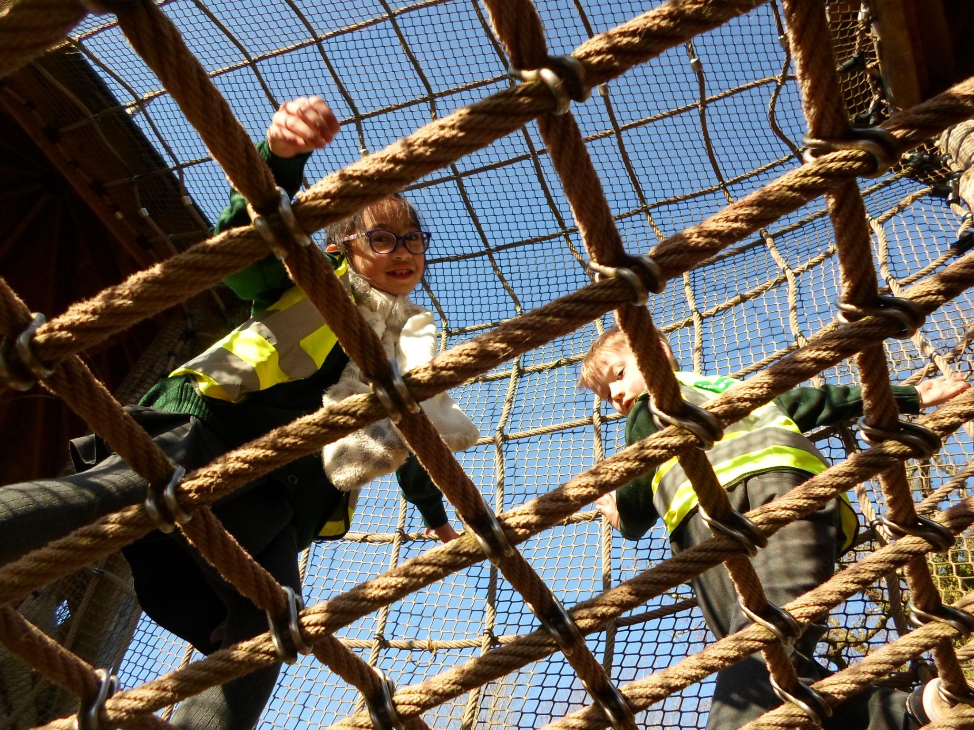
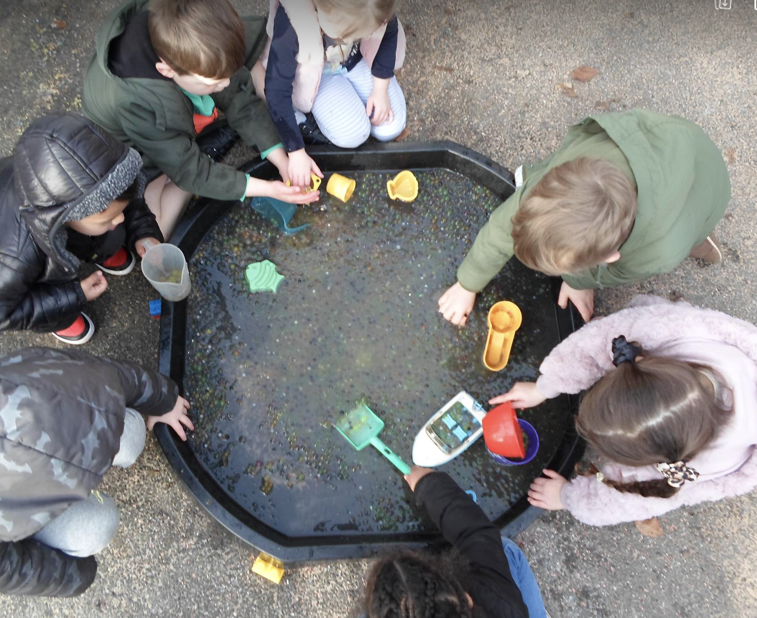
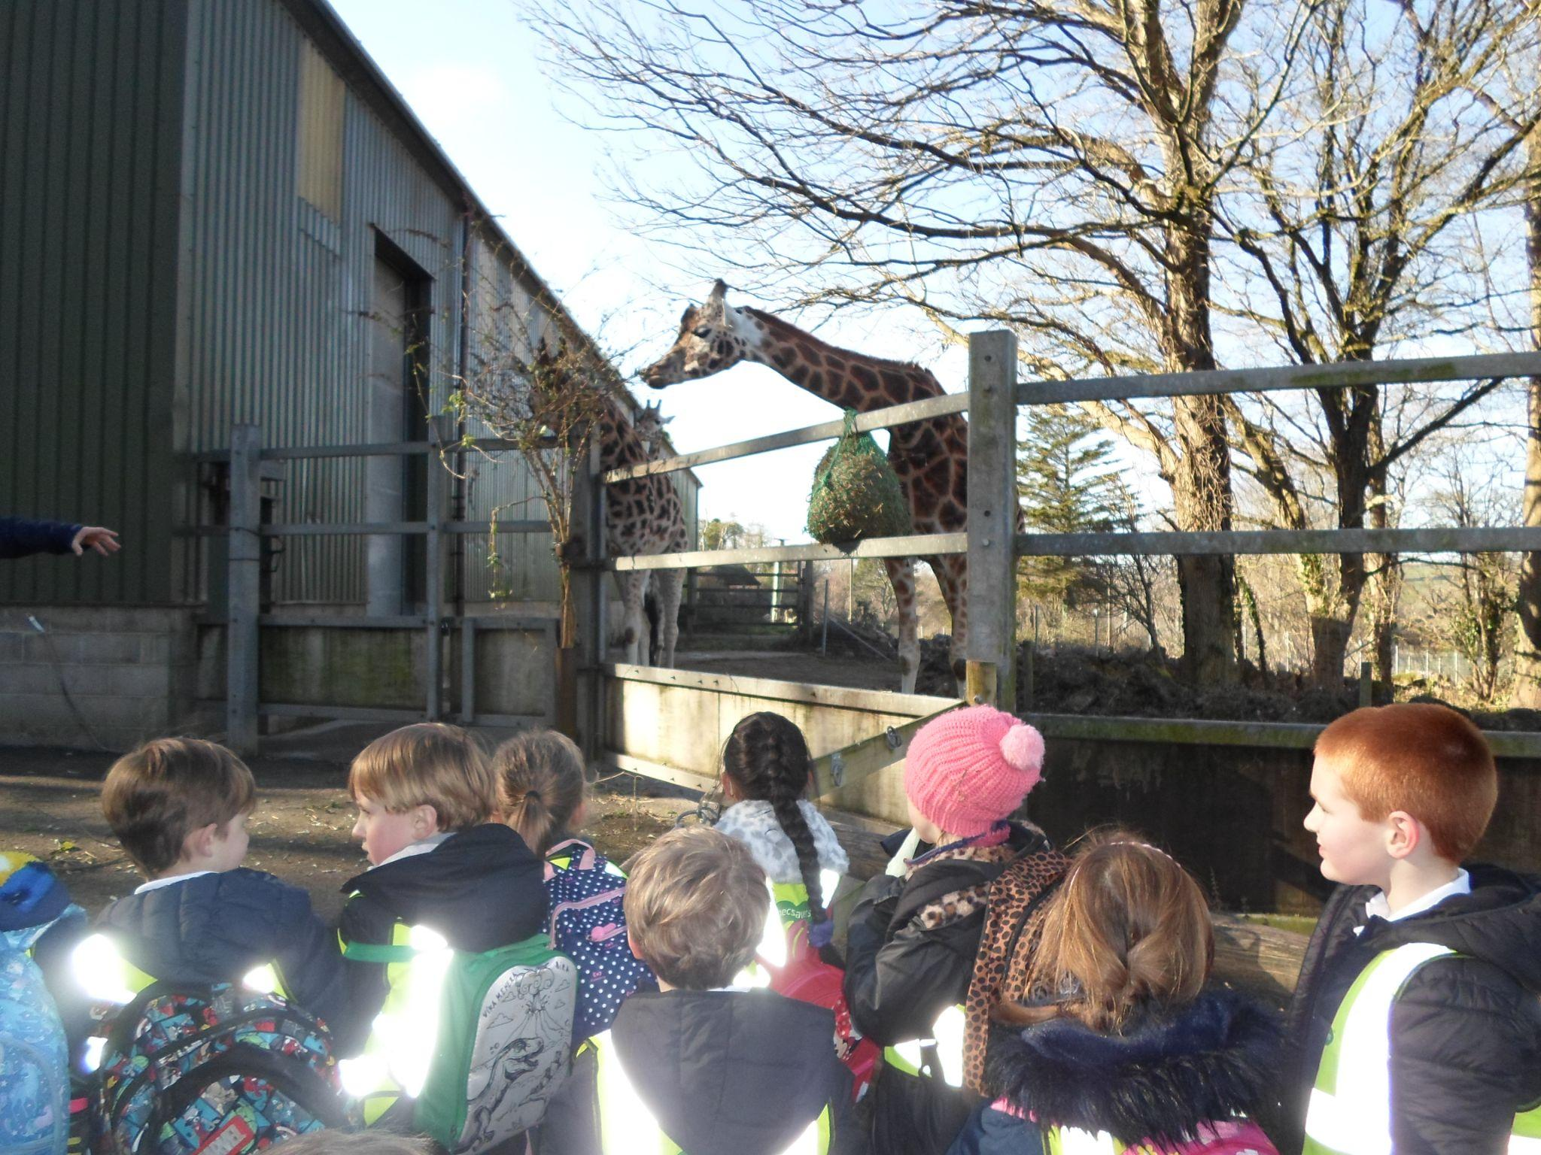
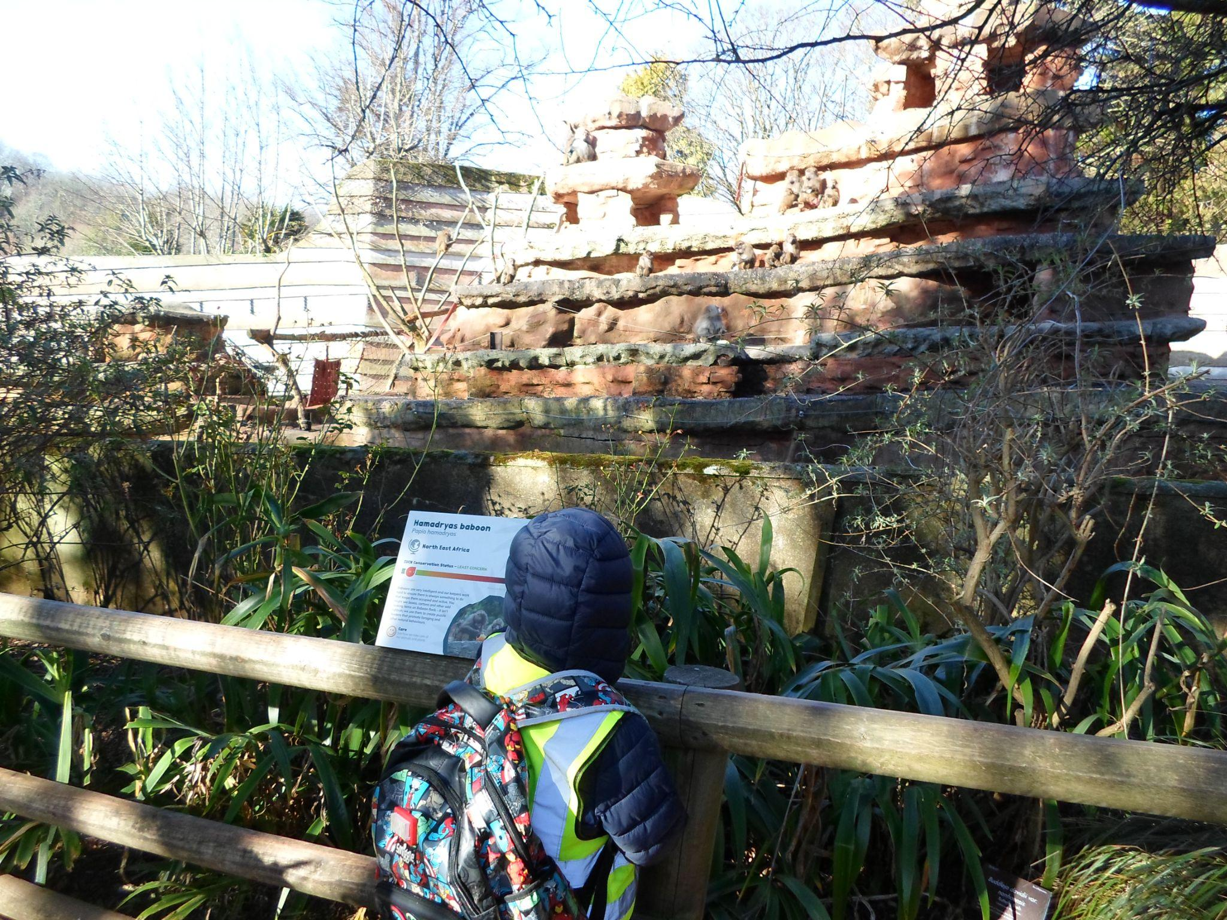
Early Years
Year 1 & 2
EYFS have loved being outside engaging with the provision and building on their oracy skills describing the aqua beads feel and move and discussing what to do next.
Year 1 and 2 had a fantastic trip to the zoo on Tuesday. In Science, we have been learning about animals and their habitats and during our visit we were able to see these habitats and talk about the environments. The children had super attitudes and showed great curiosity during our school trip. Thank you to our parent helpers for coming with us for the day.

Slide 7
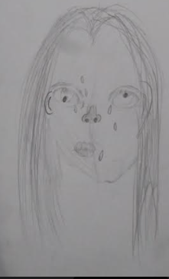
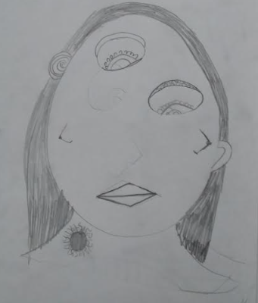
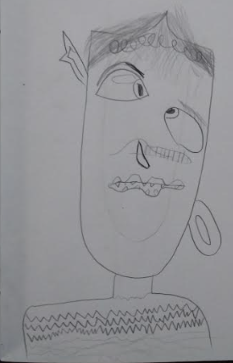
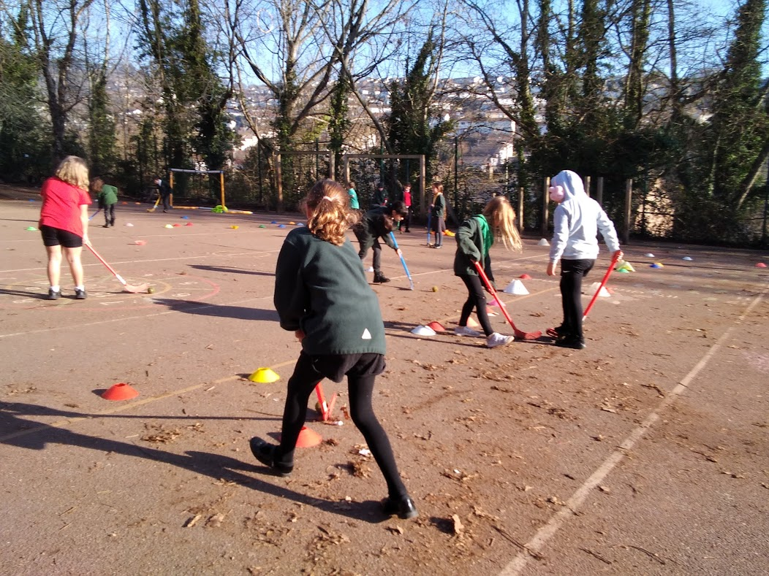
Year 3
Year 4
Across this half-term, Class 4 have been producing their self-portraits of themselves in a Picasso style fashion. The children have thought carefully about the different features that they used and how to be creative in abstract art. The children should be really proud of themselves as I know they have worked really hard in this unit. Well Done Year 4!
Looking how we ended last term, year 3 put all of their hockey skills they have been learning into a tournament style lesson against each other which they thoroughly enjoyed. We have also started our new book for Vipers - ‘There's a werewolf in my tent!’ The children have loved reading the book and picking it apart with some of our vipers skills.

Slide 8
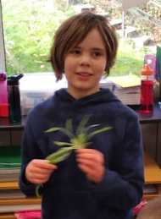
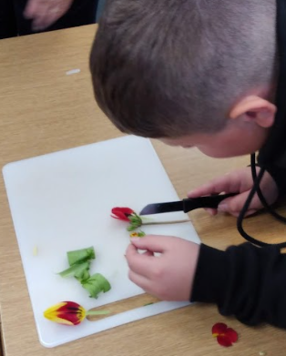
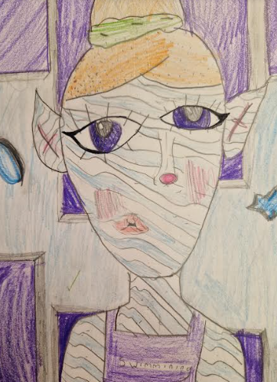
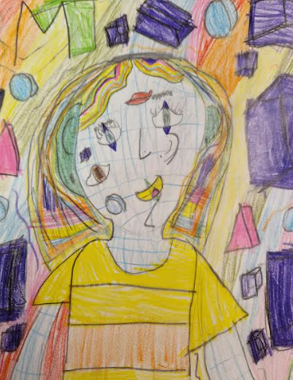
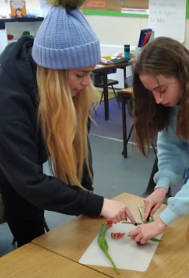
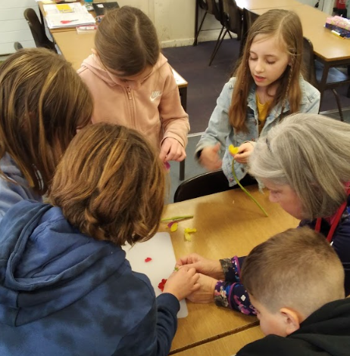
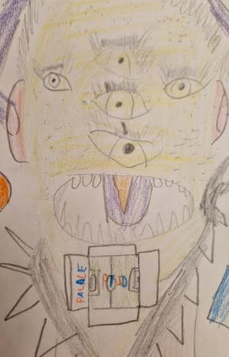
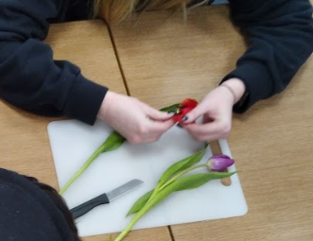
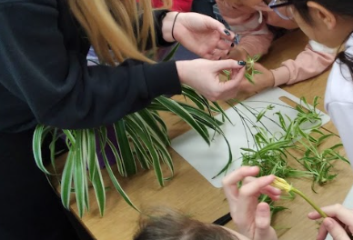
Year 5
Year 6
To finish our science unit, where the children have been learning about ‘The circle of Life’, the children looked at the reproduction of flowering and non-flowering plants.
Alison, from the botanical gardens, kindly resourced and helped us dissect flowering plants.
Class 5 now have some spiderettes and will watch them grow over next half term.
Year 6 have worked incredibly well this half term in their art lessons. They have all demonstrated creativity and the ability to create their own abstract art.

Slide 9
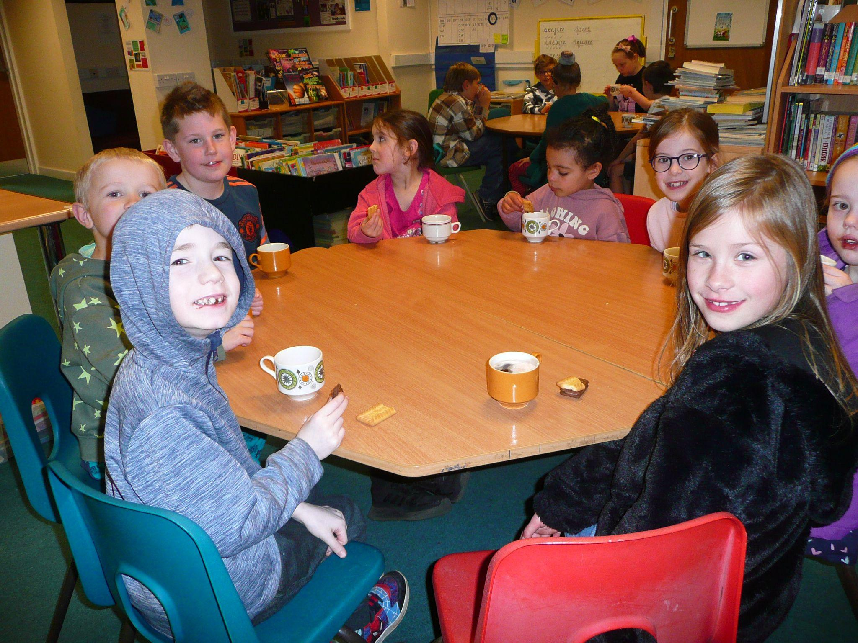
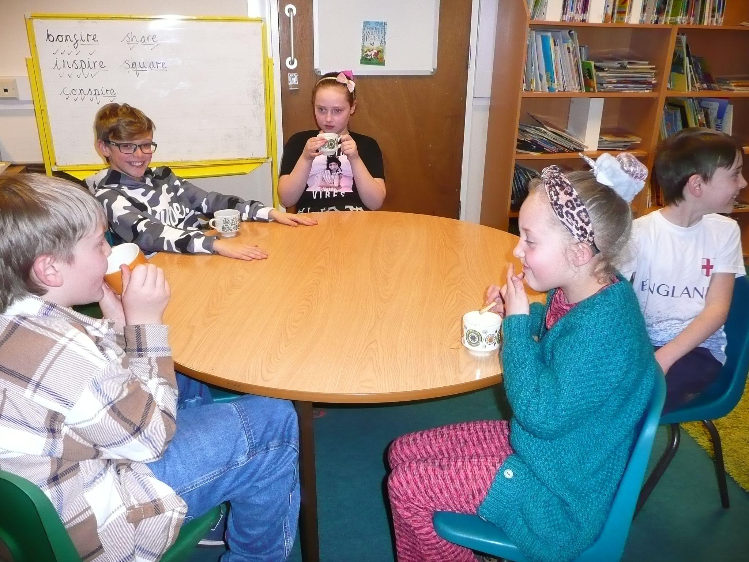
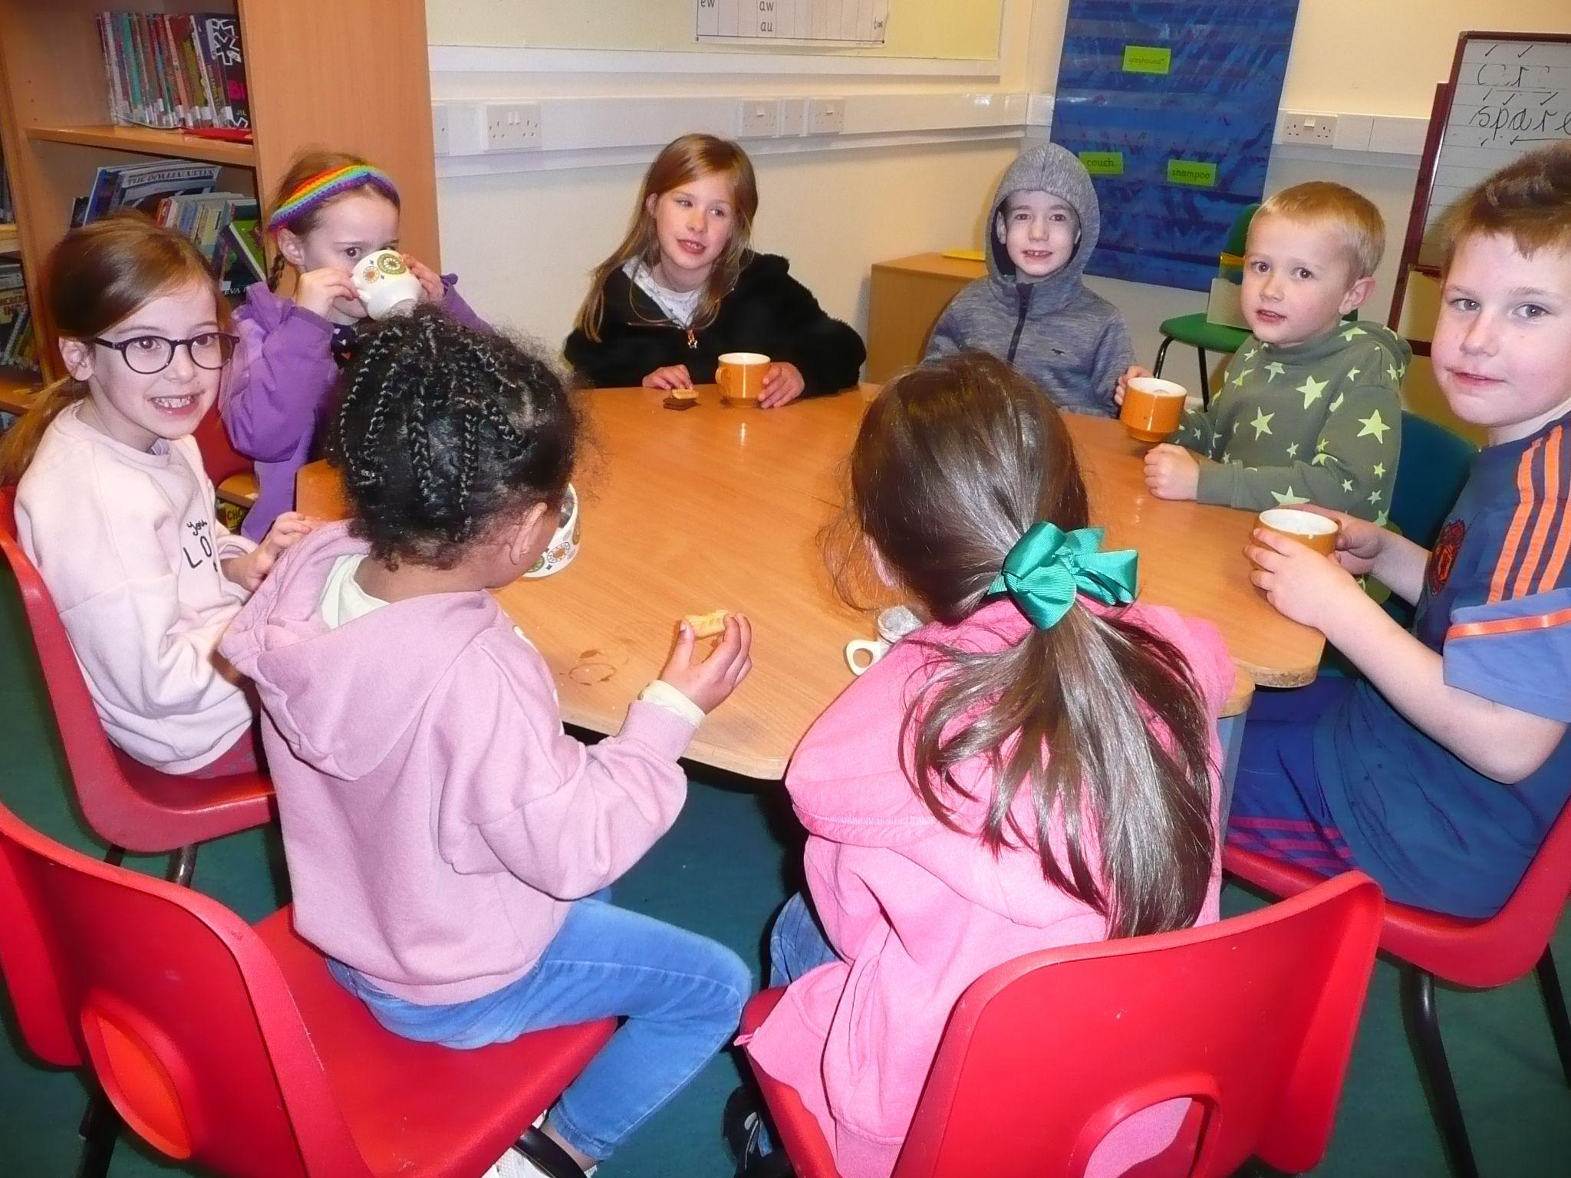
Proud at OLsp
A massive well done to this half term hot chocolate winners. Mrs Blatchford enjoyed the company of children identified across the school for being consistently well behaved and demonstrating our 3 rules:be ready, be safe, be respectful.

Slide 10
Disciple of the week
Star of the week
 | 03.2.23 | 10.2.23
 | Love | Forgiveness
Early Years | Hattie | Issac
Y1 & 2 | Izzy | Florence
Y3 | Indya | Zach
Y4 | Isaac | George
Y5 | Gracie | Amelia
Y6 | Phoebe | Oli
 | 03.2.23 | 10.2.23
Early Years | Nela | Ellie
Y1 & 2 | Matilda | All of class 1/2
Y3 | Darcie W | Molly
Y4 | Eli | Harrison
Y5 | Ivy | Ava
Y6 | Freddie | Leon

Slide 11
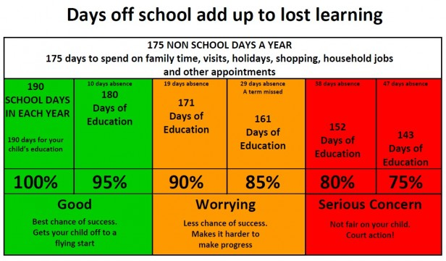
All Devon schools have been asked to sign up to a charter whereby we all aim to get our children into school at least 97% of the time.
28thJan-10th Feb 2023
Reception | 90.71
Year 1/2 | 94.33
Year 3 | 94.63
Year 4 | 93.33
Year 5 | 92
Year 6 | 93.5

Slide 12
These are the dates we have so far. We will keep you informed if more events need to be added in.
21st & 22nd Feb | Spring parent meetings | 17th March | Red Nose Day for Comic Relief
22nd Feb | 1:30pm Ash Wednesday liturgy | 21 March | Bag2School
23rd Feb | Leather jewellery making for adults | 28th March | Dawlish Water Rotary Quiz - Y6
24th Feb | Break the Rules day | 31st March | Last Day of Spring term (return 17th April)
28th Feb | Junior Speaks heats | 27th April | Y3/4 trip to Paignton Zoo
2nd March | World Book Day - come dressed as your favourite book character. Please do join us until 9:15am to share a book with the children in class. It would be great if you could bring one in with you. | 5th May pm | Coronation celebrations Join us for a shared picnic lunch, followed by activities.
7th March | Junior Speaks final | 9-12th May | Y6 SATS week
17th March | St Patrick’s Disco | 15-19th May | Y6 residential to Simonsbath
9th March | Year 4 - Mass, Saint Ignatius of Loyola. Shaldon | 26th June | Early Years trip to Paignton Zoo
14th March | Mother’s Day Gift Shop | 27th June | Y5/6 trip to Paignton Zoo

Slide 13
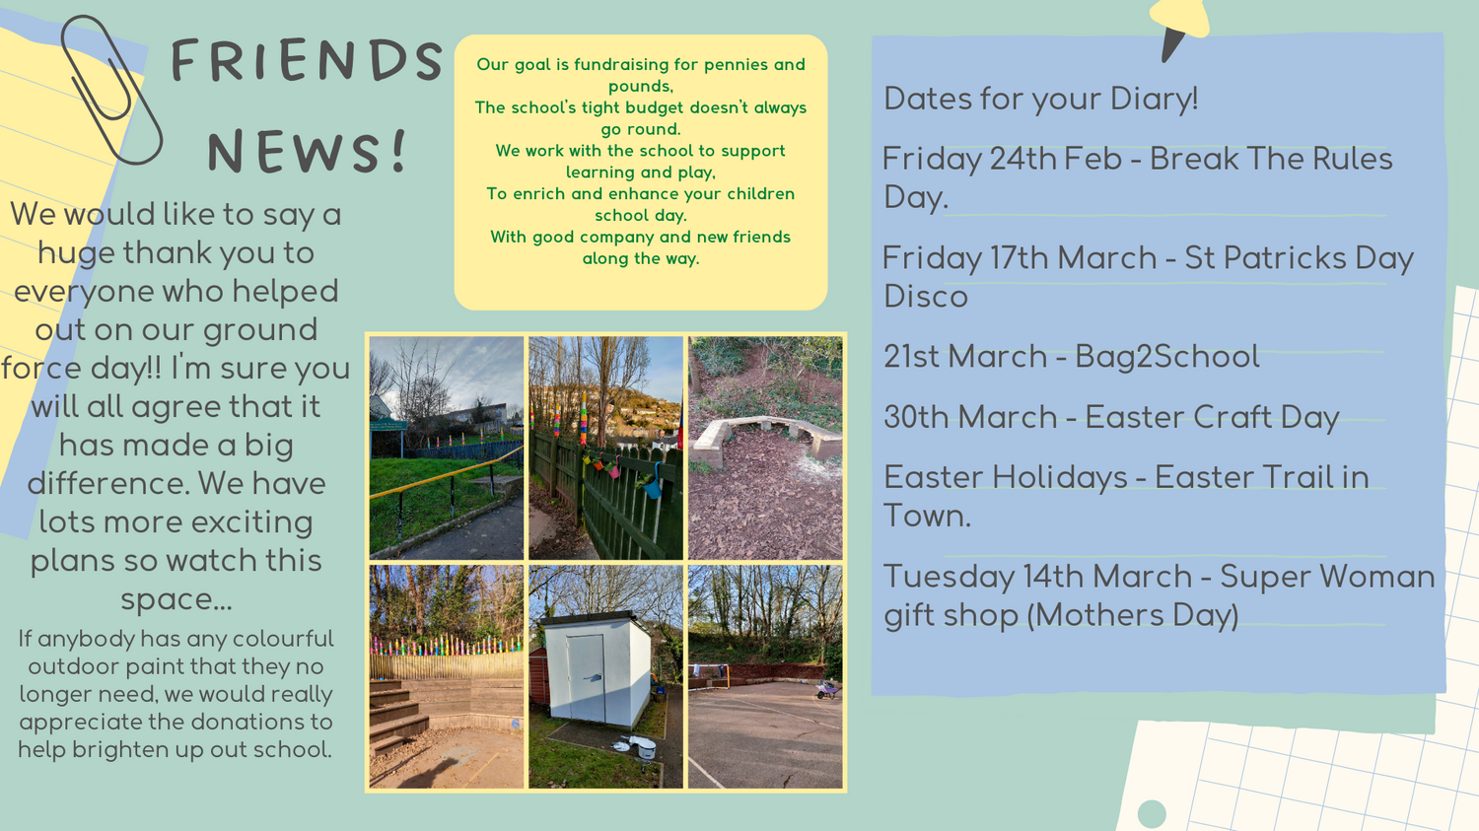
the way.

Slide 14
This newsletter we recommend
"So please, oh please, we beg, we pray, go throw your TV set away, and in its place you can install a lovely bookshelf on the wall." - Roald Dahl

Slide 15
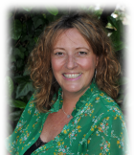
CPOMS and Operation encompass
SAFEGUARDING
At OLSP we use CPOMs as our system for recording information that we consider to be safeguarding information. As a parent you are entitled to see this information and may request to do so.
Further information about the programme can be found here -
https://www.cpoms.co.uk/privacy-statement/
Operation Encompass is the reporting to schools, prior to the start of the next school day, when a child or young person has exposed to, or involved in, any domestic incident.
Operation Encompass will ensure that a member of the school staff, known as a Key Adult, is trained to allow them to liaise with the police and to use the information that has been shared, in confidence, while ensuring that the school is able to make provision for possible difficulties experienced by children, or their families, who have been involved in, or exposed to, a domestic abuse incident.
Safeguarding at OLSP is always a priority. Should you have any enquiries or concerns, please contact our Designated Senior Lead for Child Protection: Mrs O’Sullivan, or Deputies: Mrs Blatchford or Mrs Emmerton on 01626 773905 Our named governor for child protection is Mrs Larraine Coulter
WELFARE
Our Family Support Worker is Rachel Ripley. Please let us know if you would like her to contact you for ANY support. Everyone needs a Rachel in their lives!
ATTENDANCE
Justine Williams is our attendance officer. She will liaise with any families who have a child with below 95% attendance to offer support. Please remember if attendance is below 95% your child will be noted as persistently absent.

